Slide 1
Introduction to Supervised Learning
Linear Regression, Logistic Regression, and Naive Bayes

Slide 2
Agenda
Supervised learning
Linear regression with an example
Logistic Regression with an example
Naive Bayes with an example

Slide 3
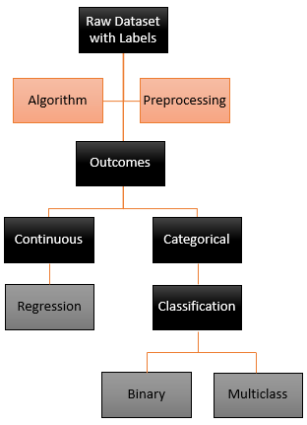
Supervised Learning
Supervised learning is defined as the use of labelled datasets for training the algorithm to either classify or predict the outcomes
There are two types of tasks depending on the outcome variable
Regression – eg: House Price Prediction
Linear regression
Classification
Binary – eg: Identification of cat or dog?
Multiclass – eg: Types of green vegetables
Logistic Regression

Slide 4
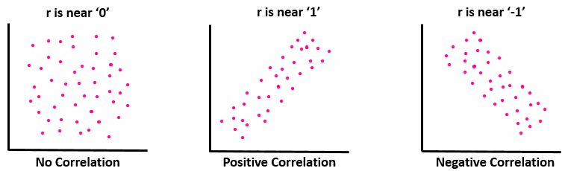
Measures of association
Linear models try to model the linear relationship between independent variables and the target
The association between the independent features and target can be modelled using
Covariance – Direction of linear relationships between two variables
Correlation – Strength and Direction of linear relationships between two variables. It is a normalized value of Covariance.
Coefficient of correlation = Pearson correlation coefficient r(x,y) = Cov(x,y) / (std(x) * std(y))

Slide 5
Linear Regression
Linear Regression Types
Simple Linear Regression:
Single Independent variable used for predicting dependent variable.
Y= mx + b
Y- Target Variable, x- Input variable, m- coefficients, b- constant
Multiple Linear Regression:
Multiple Independent variable used for predicting dependent variable.
Y= m₀x₀ + m₁x₁ + ………. + m_{n}x_{n} + b
Y- Target variable, x₀,x₁,.......x_{n} - Independent variable, m- coefficients, b- constant

Slide 6
Linear Regression - Example
Let's look at a example of multiple linear regression:
The equation is given by Y = m1*x1 + m2*x2 +........mn*xn + b
From the given example we have two independent variables(X1 and X2) and a target variable Y.
Lets us say coefficients are (m1 = 2.28, m2 = -1.67) and the intercept as 2.796
What is the value of Y?
X1 | X2 | Y
4 | 5 | 3.5
5 | 7 | 2.5
6 | 3 | 11.5
2 | 1 | ?
Using the above equation:
Y = (2.28*2) + (-1.67*1) + 2.796
Y = 5.686, is the predicted y value.

Slide 7
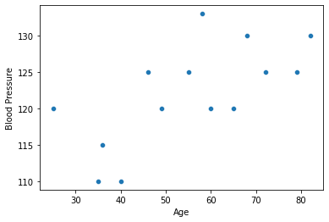
Regression Line and Cost Function
Best fit line: the line which has the least error (between actual and predicted values).
Cost function:
Cost function is the calculation of the error between predicted values and actual values
The cost function is the average error of n-samples in the data (for the whole training data).
The cost function of a linear regression is root mean squared error or mean squared error.
RMSE = √1/nΣ
n
(yi - ŷi)²
i=1

Slide 8
Error Analysis
Error term also called residual represents the distance of the observed value from the value predicted by regression line.
Therefore,
Error term = Actual value - Predicted value
for each observation
If, Equation of regression line is given by, y = β₀ + β₁x + ε then,
Error term can be calculated as, ε = y - (β₀ + β₁x)
Yactual
ε
Ypredicted

Slide 9
R squared
R squared
R-Squared (R² or the coefficient of determination) is a statistical measure in a regression model .
It shows how well the data fit the regression model (the goodness of fit).
R-squared can take any values between 0 to 1.
Regression sum of squares
SSR
r² =
=
Total sum of squares
SST

Slide 10
Adjusted R squared
Adjusted R squared
Adjusted R² is a corrected goodness-of-fit (model accuracy) measure for linear models.
The adjusted R-squared increases when the new term improves the model more than would be expected by chance.
Typically, the adjusted R-squared is positive, not negative. It is always lower than the R-squared.
(1 - R²)(N - 1)
Adjusted R² = 1 -
N - p - 1
Where,
R2 = Sample R-squared
N = Total Sample size
p= No. of independent variables

Slide 11
Fluke Correlation
For any two associated variables there can never be an instance where all the positive data points cancel all the negative data points.
Or we can say that when we plot data points for two dimensions the correlation between them can never be zero,
As in real world scenario the data points is likely to have asymmetric distribution, and therefore, R>0.
This relationship of R>0 is called Fluke Relationship.
R squared does not eliminate this statistical fluke whereas Adjusted R squared removes this statistical fluke and gives the exact results for quality of our model.

Slide 12
Linear Regression Assumptions
The dependent variable must be numeric.
Linear relationship between dependent and independent variables.
Predictors must not show multicollinearity.
Independence of observations should exist (absence of autocorrelation).
The error terms should be homoscedastic.
The error terms must follow normal distribution.

Slide 13
Let’s Answer some questions
Can we use Linear regression to predict a categorical variable?
Is 95% R-Squared a good metric?
Is this a valid equation for a linear regression model?
Y = aX₁ + bX₂ + c
Notes:
No..target should be continuous in nature…
Yes
Yes..with two dimensions it will give us a plane

Slide 14
Introduction to Logistic Regression

Slide 15
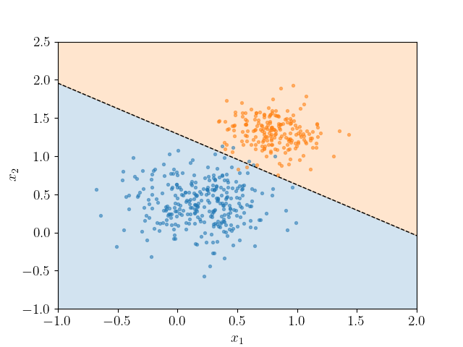
Logistic Regression - why it is called regression?
Logistic Regression is a classification method but it’s built on the same concept as linear regression and produces a linear decision boundary.
The reason for producing a linear decision boundary is because our outcome depends on the additivity of the features.
f(x) = ax1 + bx2 + c
log(p/(1-p)) = f(x)
Model has a linear component, but it introduces nonlinearity via sigmoid function.
In logistic regression, the dependent variable is a logit, which is the natural log of the odds.
Notes:
https://scipython.com/blog/plotting-the-decision-boundary-of-a-logistic-regression-model/

Slide 16
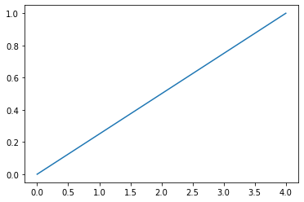
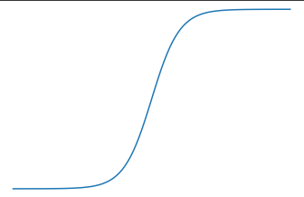
What is sigmoid function?
Logistic function is also called as sigmoid.
Function which is given by,
Probability of passing exams Vs hours of study
1
e^{f(x)}
Probability of passing the exam
S(x) =
=
1+e^{-f(x)}
1+ e^{f(x)}
It maps predicted values to probabilities
Value ranges between 0 and 1
Hours of study

Slide 17
How it works - Theory
Logistic Regression is a statistical technique that predicts probability of a target variable
Based on these probabilities the data points are labelled.
Probability of an outcome (y) is calculated using sigmoid function f(x) = (1/(1+e^{-f(x)}) which is then used to decide the class based on the threshold value.
A threshold (or cut-off; commonly a threshold of 0.5 is used) is fixed, then
f(x) = a+bx
log(p/(1-p)) = f(x)
log(p/(1-p)) = a+bx
p/(1-p) = e^{f(x)}
p(y) = 1/(1+e^{-f(x)})
p(y) = 1/(1+e^{-(a+bx)})
Note: Logarithm or logit transformation is used to model the non-linear relationship between Y and X by transforming Y.
 | Classify as
Probability > threshold | 1
Probability < threshold | 0

Slide 18
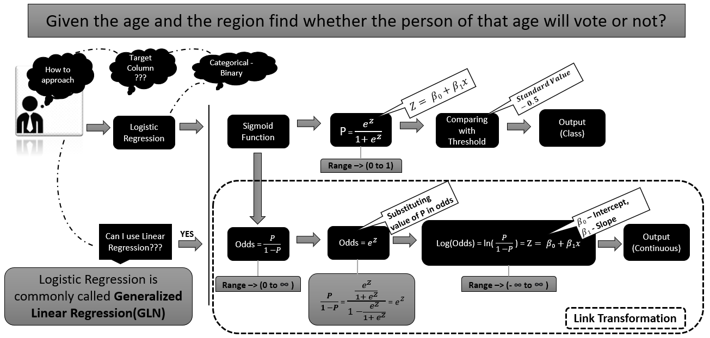
How it works - Theory

Slide 19
Log Loss
Linear regression minimize the sum of squared error for finding the best fit line. This unfortunately will not work in logistic regression.
Instead we choose to minimize the “Log Loss” or “Cross-Entropy” to find the best fit curve.
Probability of passing exams Vs hours of study
Best
Probability of passing the exam
-ylog(ŷ) - (1-y)log(1-ŷ)
Hours of study
Correct classification contributes very minimal to the sum while a incorrect classification contributes large magnitudes.

Slide 20
Multinomial Logistic Regression
It is a classification technique that extends the logistic regression algorithm to solve multiclass possible outcome problems, given one or more independent variables.
This model is used to predict the probabilities of categorically dependent variable, which has two or more possible outcome classes.
Which Flavor of ice cream will a person choose?
Dependent Variable:
Vanilla
Chocolate
Butterscotch
Black Currant

Slide 21
Threshold optimization
Logistic regression return a probability value which ranges between 0 to 1.
To assign a class based on the returned probability value, a cut-off value ( Threshold) is used to segregates the instances into classes.
Let’s say, threshold = 0.5. Instances with probability value > 0.5 will belong to one class and with value <0.5 will belong to another class.
You can use ROC/AUC curve or check FP and FN to optimize the threshold value.
Note - By optimizing the threshold we trade off TP for FN, and FP for TN. Changing threshold does not change the coefficients of the model it just updates the FP and FN.

Slide 22
Logistic Regression - Example
Let's look at a example of Logistic regression:
The equation is given by f(x) = m1*x1 + m2*x2 +........mn*xn + b
From the given example we have two independent variables(X1 and X2) and a target variable Y.
Lets us say coefficients are (m1 = 2.28, m2 = -1.67) and the intercept as 2.796
What is the value of Y?
Using the above equation:
f(x) = (2.28*2) + (-1.67*1) + 2.796
f(x) = 5.686, is the predicted value for f(x)
p(y) = 1/(1+e^{-f(x)}) = 1/(1 + e^{-5.686}) = 0.99
If we consider 0.5 as the threshold value, Y > 0.5 will be equal to one and rest will be zero. Hence our predicted value of Y will be 1.
X1 | X2 | Y
4 | 5 | 0
5 | 7 | 0
6 | 3 | 1
2 | 1 | ?

Slide 23
Performance Measure
Confusion Matrix for Binary-Class
50 { 30 P and 20 N} | Actual ( y=1) {1 is positive} | Actual ( y=0)
Predicted (y = 1) | TP (26) | FP (2)
Predicted (y = 0) | FN (4) | TN (18)
True Positive : predicted and actual values are true.
True Negative : predicted and actual values are false.
False Positive (Type 1 Error) : predicted is true and actual value is false.
False Negative (Type 2 Error) : predicted is false and actual value is true.
Notes:
Graph taken from hands-on

Slide 24
Performance Measure
Precision and Recall
Precision : TP / (TP + FP) it is the ratio of true positives to the total positive predictions.
Recall : TP / (TP + FN) its is the ratio of true positives to the total actual positives observations. It is also known as sensitivity or TPR.
F1 Score : it is the harmonic mean of precision and recall
F1 Score = 2*(Recall * Precision) / (Recall + Precision)
Notes:
Graph taken from hands-on

Slide 25
Performance Measure
ROC Curve
ROC curve is a plot between TPR vs FPR, as the threshold value is increased from zero to one
A good model need to correctly identify positive as positive and a negative as a negative.
Hence it should have high sensitivity (TPR) and low FPR (1-specificity) which will result in the ROC curve close to left corner of the plot.
ROC curve shows that if AUC is more than 0.7 ( ROC line above the diagonal line ) then the model is able to make the correct predictions for most of the thresholds.
A model with no discrimination ability will have an ROC curve which is the 45 degree diagonal line.
True Positive rate(TPR)
False Positive rate(FPR)
Notes:
Graph taken from hands-on

Slide 26
Let’s Answer some questions
Can we use Logistic regression to predict a multi class variable?
Is 95% accuracy a good metric?
What is the difference between linear and logistic regression?
Notes:
Yes
Yes. But we Can’t say if all the classes are represented. We should check precision and recall

Slide 27
Bayes Theorem, Conditional probability, and Naive Bayes

Slide 28
Bayes and connection with Conditional Probability
Bayes theorem describes the probability of an event which is based on the preceding events. The bayes theorem is the extended version of conditional probability.
Using conditional probability, Bayes theorem provides a way to calculate posterior probability P(A|B) from P(A), P(B) and P(B|A)
P(A∩B)
The probability of event A given B is:
P( A|B) =
P(B)
The probability of event B given A is:
P(A∩B)
P( B|A) =
Using above two equations,
P(A)
P( A|B) =
P(B|A)*P(A)
P(B)
, known as Bayes theorem.

Slide 29
Bayes Theorem Example
Independent probabilities:
P(A): Probability that the card is Red (event A)
=> 26/52
P(B): Probability that the card is King (event B )
=> 4/52
P( B| A)- Conditional probability - Probability that the card is King (B) given it is Red (B)
2/26
P( A | B): Posterior probability - Probability that the card is Red (A) given it is King (B)
=> P ( B | A) * P (A) / P (B)
=> (2/26) *(26/52)/ (4/52)
= 2/4
P( A|B) =
P(B|A)*P(A)
P(B)

Slide 30
Bayes Theorem for multiple features
The Bayes rule computes the probability of class A for given B feature.
In real life problems, the target class A depends on multiple B variables. So, the formula of bayes rule can be extended for multiple input features like,
P(A| B1, B2, B3,...Bn) = P(B1, B2, B3,...Bn | A) * P(A)
P(B1, B2, B3,...Bn)
According to the naïve assumption of input features are independent,
P(A| B1, B2, B3,...Bn) = P(B1|A)* P(B2|A)*... P(Bn|A)* P(A)
P(B1)*P(B2)*P(B3)*...P(Bn)
Note - The Bayesian classifier works on maximum a posterior or MAP decision rule

Slide 31
Naive Bayes
It estimates conditional probability which is the probability that event A will happen, given that event B has already occurred.
Hence, used to classify target column based on given features
It assumes that the features are independent.
It is easy to implement, fast, accurate, and can be used to make real time predictions.
Naive Bayes Classifier
Used for Classification
Based on Bayes’ theorem
Has a simplistic assumption that the features in dataset are independent from each other

Slide 32
Naive Bayes
The Bayes rule computes the probability of class Y for given X features. In real life problems, the target class Y depends on multiple X variables. So, the formula of bayes rule can be extended for multiple input features like,
P(Y|X1,X2,X3,....Xn)
P(X1, X2, X3,....Xn|Y) * P(Y)
=
P(X1, X2, X3,.....Xn)
According to the naive bayes assumption of input features are independent,
P(Y|X1,X2,X3,....Xn)
P(X1|Y) * P(X2|Y) *.…..P(Xn|Y) * P(Y)
=
P(X1) * P(X2) * P(X3)*.....P(Xn)

Slide 33
Steps of a Naive Bayes Classifier
Compute the prior probabilities for given class labels.
Compute the Likelihood of evidence with each attribute for each class.
Calculate the posterior probabilities using Bayes rule.
Select the class which has higher probability for given inputs.

Slide 34
Business Problem - label the email as spam or ham
We shall consider the problem of labelling the received emails as spam or ham
Choose a few words you find in emails
Work
Snacks
Money
Horoscope
Good
Lonely
Consider the frequency of these words used in spam and ham emails as shown below:
 | Spam | Ham
Good | 2 | 10
Lonely | 2 | 1
Horoscope | 20 | 5
Work | 5 | 12
Snacks | 0 | 5
Money | 21 | 7
Total | 50 | 40

Slide 35
Business Problem - label the email as spam or ham
Step1: Obtain the prior probability.
The prior probabilities are,
P(Spam) = 50/90 => 0.55
P(Ham) = 40/90 => 0.45

Slide 36
Business Problem - label the email as spam or ham
Step2: Obtain the likelihood
The probability that the word Good appears in a Ham email, ie P(Good | Ham) is = 10/40 = 0.25.
Similarly we can fill the entire table
 | Spam | Ham
Good | 2 | 10
Lonely | 2 | 1
Horoscope | 20 | 5
Work | 5 | 12
Snacks | 0 | 5
Money | 21 | 7
Total | 50 | 40
 | Spam | Ham
Good | 2/50 = 0.04 | 10/40 = 0.25
Lonely | 2/50 = 0.04 | 1/40 = 0.025
Horoscope | 20/50 = 0.4 | 5/40 = 0.125
Work | 5/50 = 0.1 | 12/40 = 0.30
Snacks | 0/50 = 0 | 5/40 = 0.125
Money | 21/50 = 0.42 | 7/40 = 0.175
Obtain the likelihoods

Slide 37
Business Problem - label the email as spam or ham
Step3: Compute posterior probabilities for
A given email has Good Work mentioned in it, is it a spam/ham message??
Our instance is Good Work.
For our instance, compute the posterior probabilities for each of the class labels - spam or ham

Slide 38
Business Problem - label the email as spam or ham
Compute the posterior probabilities for each the class labels - Spam or Ham
For Spam,
P(Spam| Good, Work) = P(Spam) . P(Good | Spam). P(Work | Spam) = (0.55) . (0.04) . (0.1) = 0.0022
 | Spam | Ham
Good | 2/50 = 0.04 | 10/40 = 0.25
Lonely | 2/50 = 0.04 | 1/40 = 0.025
Horoscope | 20/50 = 0.4 | 5/40 = 0.125
Work | 5/50 = 0.1 | 12/40 = 0.30
Snacks | 0/50 = 0 | 5/40 = 0.125
Money | 21/50 = 0.42 | 7/40 = 0.175
For Ham,
P(Ham| Good, Work) = P(Ham) . P(Good | Ham). P (Work | Ham) = (0.45) . (0.25) . (0.30) = 0.033

Slide 39
Business Problem - label the email as spam or ham
Step4: Assign the most probable class label.
For Spam,
P(Spam| Good, Work) = 0.0022
For Ham,
P(Ham| Good, Work) = 0.033
Since 0.033 > 0.0022, we assign the class label as Ham to the instance Good Work.

Slide 40
Types of Naive Bayes Classifier
Used when features are continuous. Assumes that variable x is normally distributed which is used to calculate probability density.
Gaussian NB
Good for text classification. When data is multinomial distributed. This classifier treats each occurrence of a word as an event.
MultiNomial NB
Bernoulli NB
Used when you have multiple features that are assumed to be binary.
Notes:
Diagram created internally

Slide 41
Summary
In this module we discussed:
Supervised Learning
Linear regression
Measures of association
Regression line, cost function, error analysis, performance measures, Fluke correlation, and assumptions in linear regression.
Logistic regression
Sigmoid function and log loss.
Multinomial logistic regression, threshold optimization, and performance measures.
Bayes theorem, Conditional probability, and Naive Bayes
Bayes Theorem and connection with conditional probability
Naive bayes classifier and Steps of naive bayes classification, and types of Naive bayes classifier
Notes:
Diagram created Internally

Slide 42
Thank you Happy learning ☺

